Slide 1

Python project
Group-42
Linear Regression
Submitted By:
Sri Harsha Gullapalli
Hadhvika Bodepudi
Vamshi Rahul

Slide 2
AIM
To predict and build a linear model for calculating the best price for the used BMW car’s which the customer wants to buy.

Slide 3
DATASET
The dataset is available in public and can be downloaded through https://www.kaggle.com/mysarahmadbhat/bmw-used-car-listing?select=bmw.csv . The dataset would return the following features like:
Model, Year, Price, Transmission, Mileage, Fuel, Tax, MPG and Engine.

Slide 4
INTRODUCTION
The prices of new cars in the industry is fixed by the manufacturer with some additional costs incurred by the Government in the form of taxes. So, there is a need for a used car price prediction system to effectively determine the worthiness of the car using a variety of features. Even though there are websites that offers this service, their prediction method may not be the best. Besides, different models and systems may contribute on predicting power for a used car’s actual market value. It is important to know their actual market value while both buying and selling

Slide 5

LINEAR REGRESSION
What is meant by Linear regression?
Linear Regression tries to establish a linear relationship between the independent variables and the dependent variables.

Slide 6
Exploratory Data Analysis
We use Linear Regression model for predicting the price and to visualize the data we use seaborn and matplot libraries. Also we use other pandas libraries to handle the dataframe such as Numpy, Sklearn. There are no null values present in the dataset but there are some outliers. So we need to remove the outliers using log transformation to get the accuracy of the prediction. Also the values of tax and engine size is zero, so we change those value to null and make them zero. We removed the duplicate values present in the data.

Slide 7

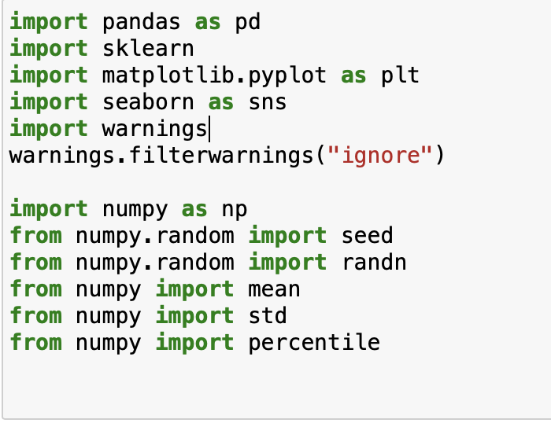
IMPORT OF LIBRARIES

Slide 8
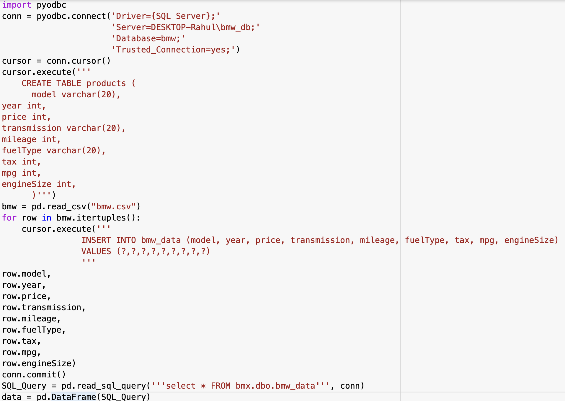
CREATING SQL SERVER AND LOADING THE DATA
Here we created a SQL server and imported the csv file into it.

Slide 9
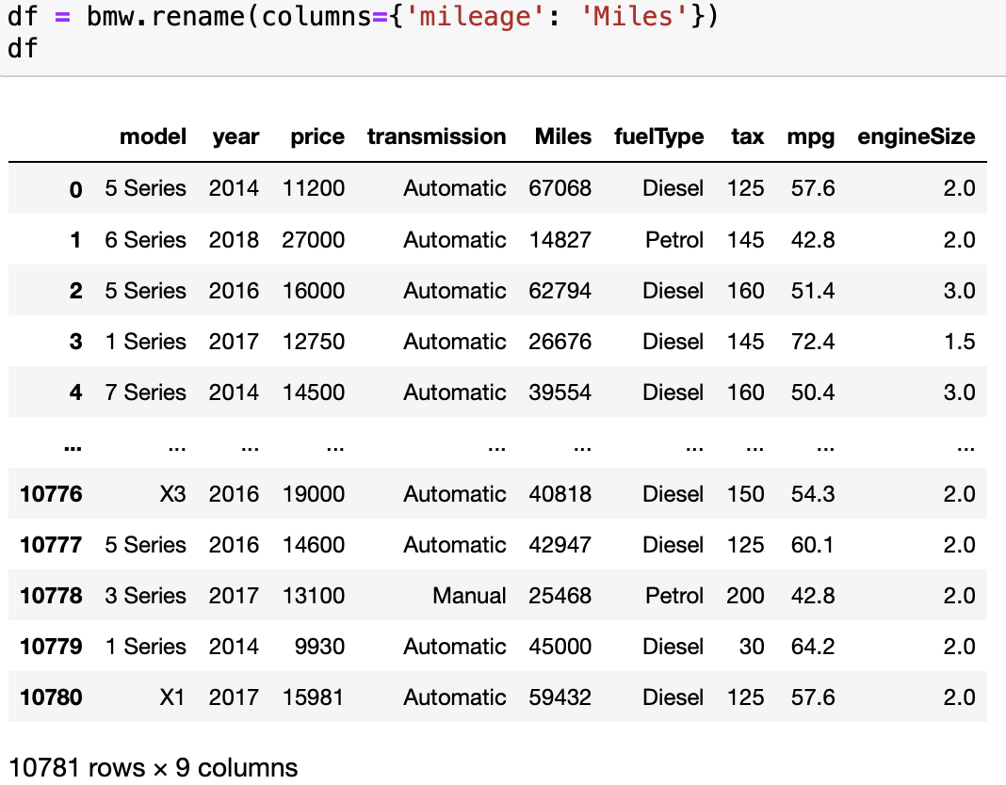
DATASET INSIGHT
This shows the head and tail of the data that is the first five rows and the last five rows of a data. For better understanding, we have renamed the column name mileage as Miles.

Slide 10
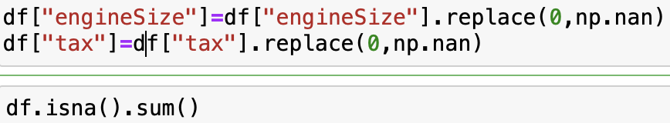
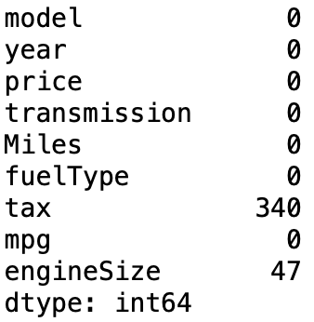
IDENTIFYING NULL VALUES AND MAKING THEM ZERO
As we can see . There are no null values present in the data set. But there are some problem of outliers! also the value of tax and engine size to 0.

Slide 11
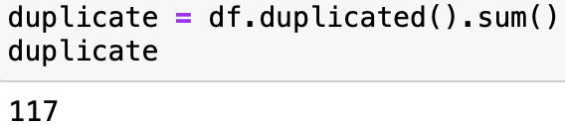

REMOVING OF DUPLICATE VALUES

Slide 12
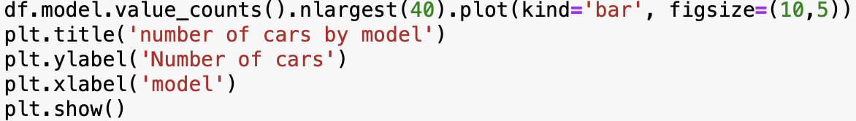
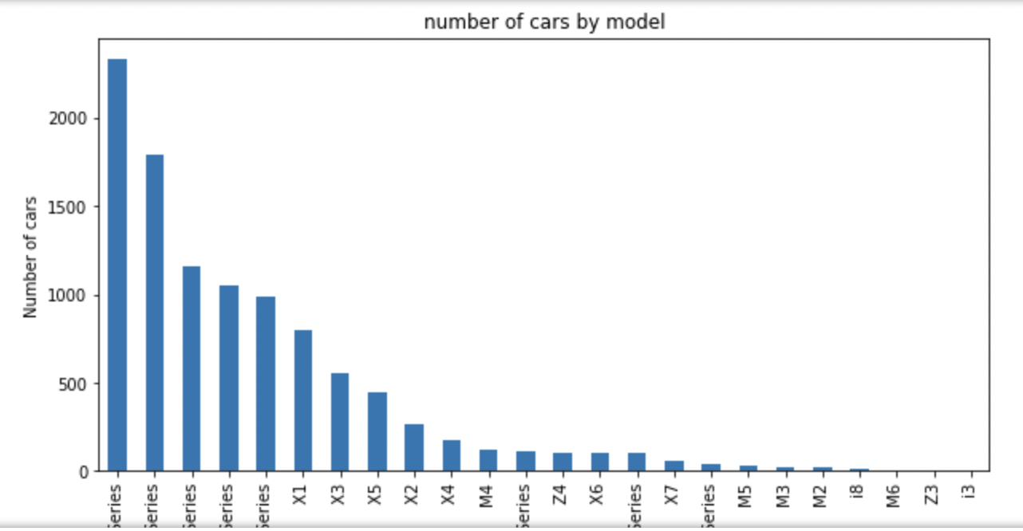
HISTOGRAM PLOT

Slide 13
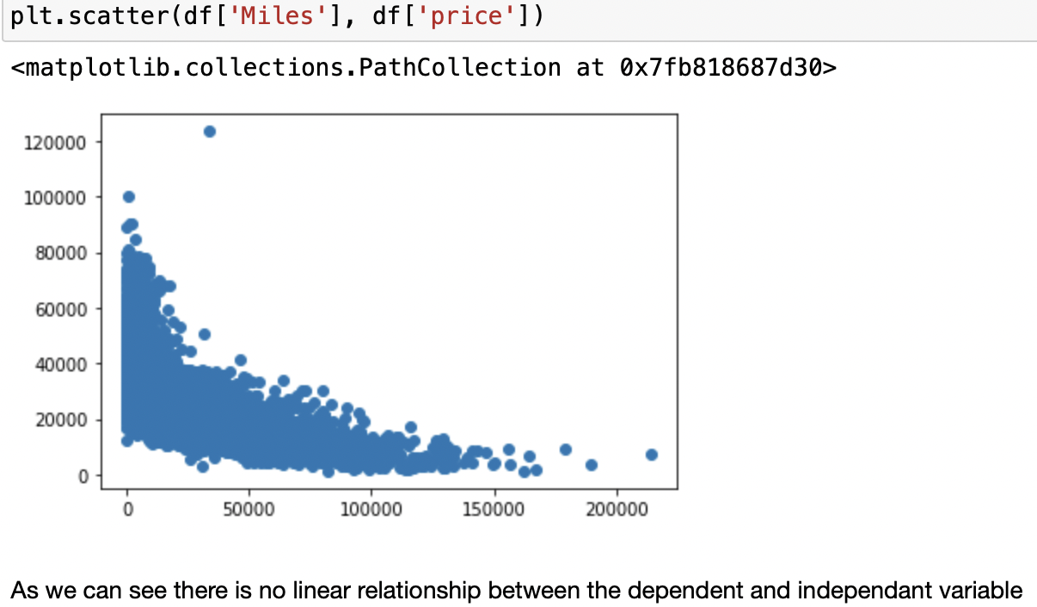
SCATTER PLOT
Observation: As we can see there is no linear relationship between the dependent and independent variable

Slide 14
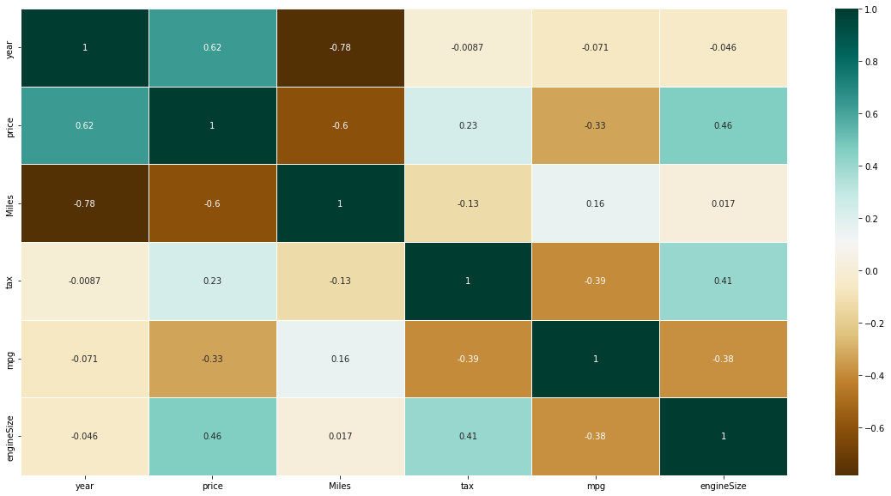
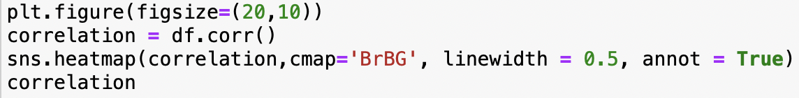
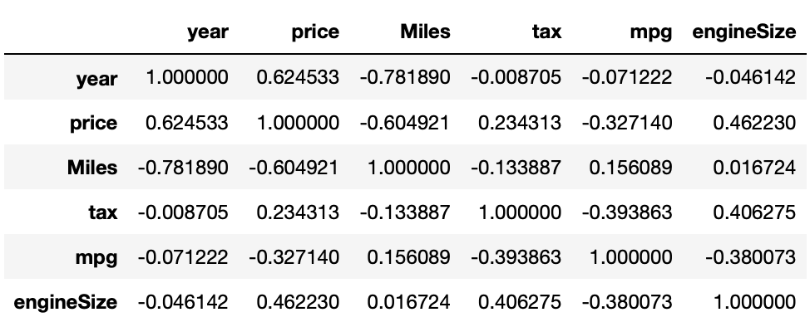
HEAT MAP

Slide 15
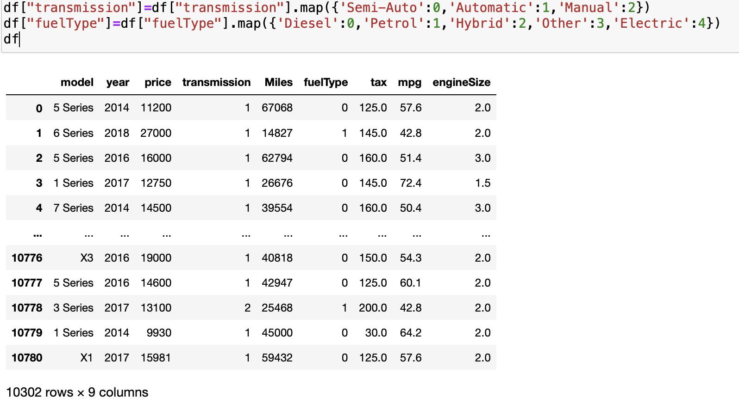
CATEGORICAL VALUES TO NUMERICAL VALUES
As we know that the Machine learning model takes only numerical values. so we will change some categorical values to numerical values

Slide 16
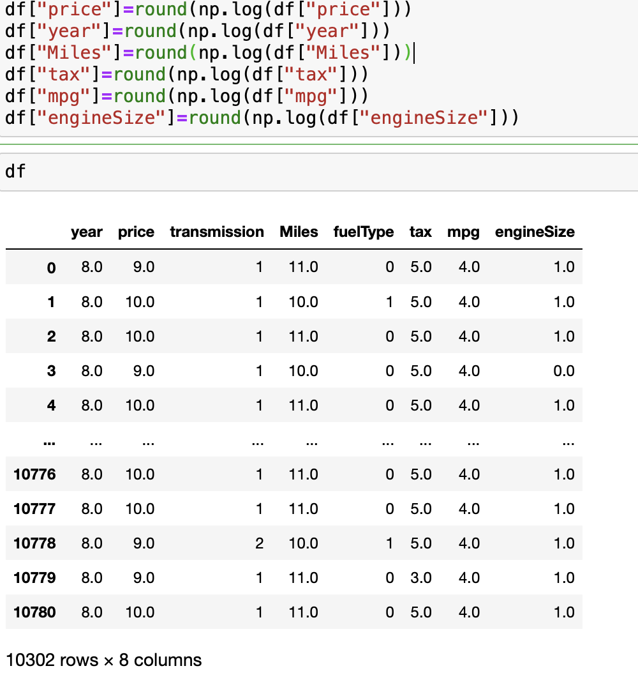
We know that in the regression analysis the response variable should be normally distributed to get better prediction results. Also it is one of the assumption that we have to follow. From the Eda we get to know that there are so many outliers present in the data set . Let's handle those also! We will use Log Transformation
Rounding of values

Slide 17
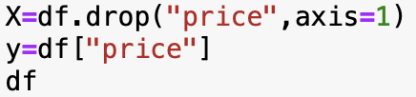
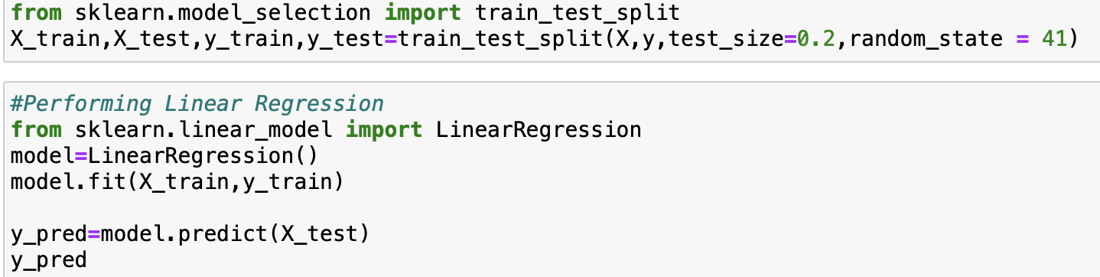
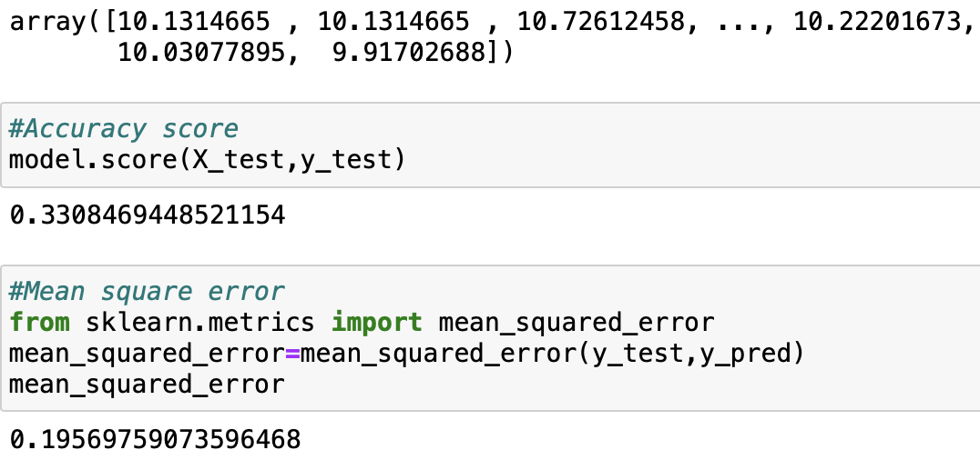
PERFORMING LINEAR REGRESSION Accuracy score : 33% Mean square error :0.19 Train data : 80% Test data : 20%

Slide 18
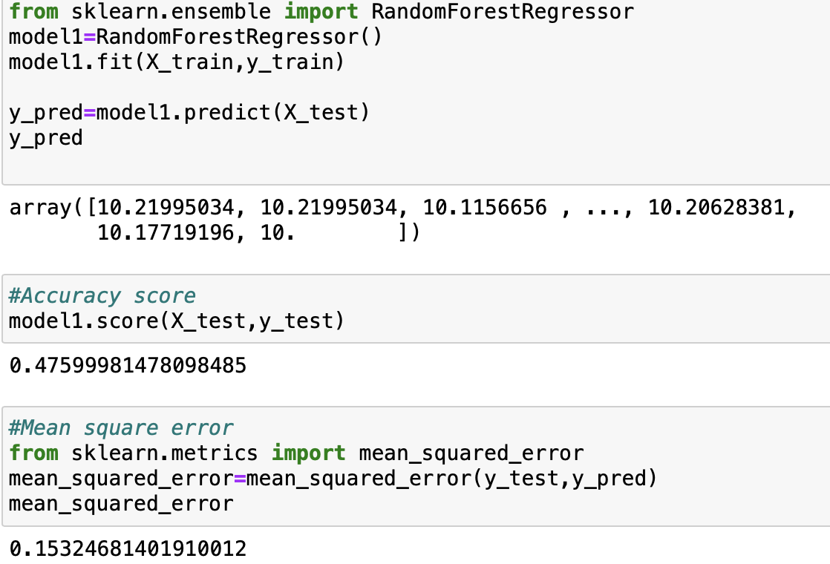
RANDOM FOREST REGRESSOR
As we got a low accuracy score in linear regression but a well mean square error which resembles that our model is running well . So, we tried with the random forest regressor. The accuracy score have increased to 47% with mean square error value as 0.15.
Accuracy Score : 0.477
Mean Square Error:0.15

Slide 19
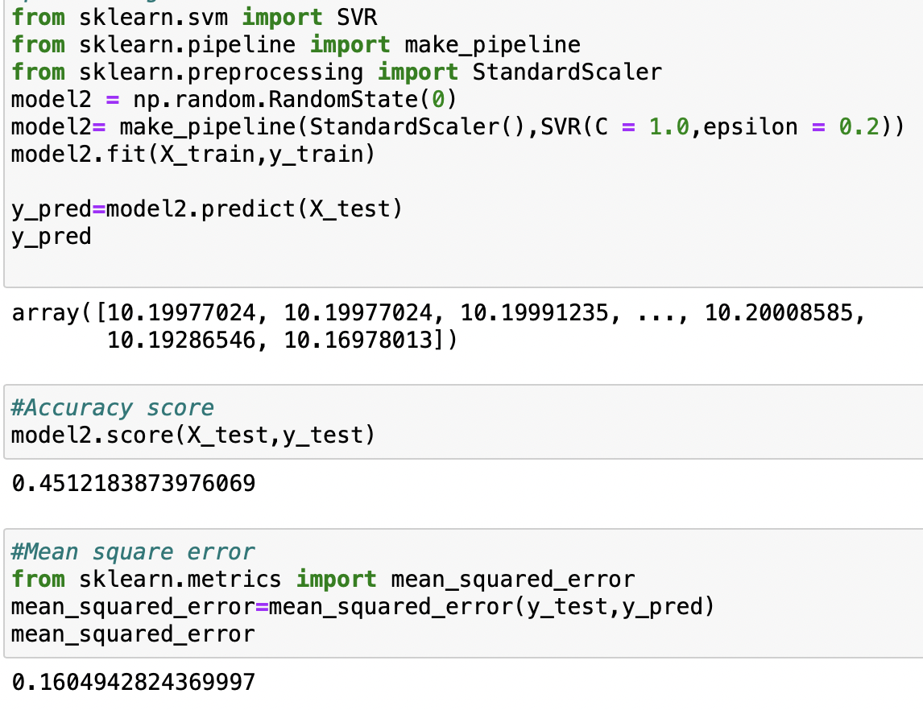
SINGULAR-VALUE DECOMPOSITION
With the same train and test data we performed a SVD model with epsilon value as 0.2 . After performing it we got an accuracy score of 45% and mean square error value as 0.16 .
Accuracy Score :45%
Mean Square Error :0.16

Slide 20

THANK YOU Sri Harsha Gullapalli Hadhvika bodepudi Vamshi Rahul

